Slide 1

Social media Analytics Experiment No 10
Sanket mane (24)
Dattatray Mundhe(28)

Slide 2
Introduction
Sentiment analysis, also known as opinion mining, is a technique used in social media analytics to analyze and understand the sentiment or emotional tone expressed in textual data, such as social media posts, comments, reviews, and other forms of user-generated content. It involves automatically categorizing the sentiment of the text as positive, negative, or neutral. Here's an explanation of sentiment analysis in the context of social media analytics:
Understanding Sentiment: Sentiment analysis aims to understand the underlying sentiment or opinion expressed in textual data. It helps in determining whether the sentiment conveyed by a piece of text is positive, negative, or neutral.
Text Processing: Sentiment analysis starts with text processing, which involves tokenization (breaking text into words or phrases), removing stopwords (commonly occurring words that do not carry significant meaning), and stemming or lemmatization (reducing words to their base or root form).
Sentiment Classification: After text processing, sentiment analysis algorithms classify the text into different sentiment categories. There are various approaches to sentiment classification, including rule-based methods, machine learning techniques (such as Naive Bayes, Support Vector Machines, and Neural Networks), and lexicon-based methods.

Slide 3
Use in Business:
Brand Monitoring: Businesses use sentiment analysis to monitor the sentiment surrounding their brand, products, and services across social media platforms.
Competitor Analysis: Sentiment analysis allows businesses to monitor the sentiment surrounding their competitors' brands and products. By comparing sentiment trends, businesses can identify competitive strengths and weaknesses and capitalize on market opportunities.
Customer Feedback Analysis: Sentiment analysis helps businesses analyze customer feedback from social media channels. By categorizing feedback as positive, negative, or neutral, businesses can identify recurring themes, issues, and pain points raised by customers.
Reputation Management: Sentiment analysis is essential for reputation management, enabling businesses to track and manage their online reputation effectively.
Market Research and Trend Analysis: Sentiment analysis provides valuable insights for market research and trend analysis. By analyzing sentiment across social media conversations, businesses can identify emerging trends, consumer preferences, and market sentiments.

Slide 4
Classifying reviews
Gather reviews from various sources such as e-commerce platforms, social media, review websites, or internal customer feedback systems. Ensure that the data covers a diverse range of products or services and represents different customer experiences.
Sentiment Analysis: Use sentiment analysis techniques to determine the sentiment expressed in each review. Common approaches include:
Lexicon-based methods: Assign sentiment scores to words based on a predefined sentiment lexicon or dictionary. Calculate the overall sentiment score for the review by aggregating the scores of individual words.
Machine learning algorithms: Train a sentiment classification model on labeled review data to predict the sentiment of new reviews. Features may include word embeddings, TF-IDF vectors, or n-grams.
Sentiment Classification: Classify reviews into positive, negative, or neutral categories based on their sentiment scores. Define thresholds or rules to determine the sentiment polarity of each review. For example, reviews with a sentiment score above a certain threshold may be classified as positive, while those below the threshold are negative.

Slide 5
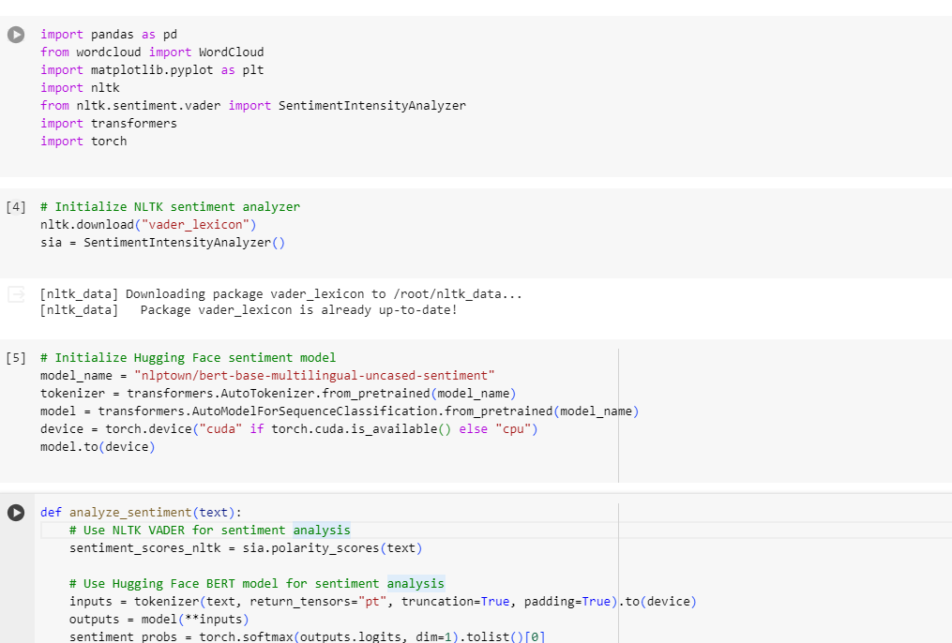
Sentiment analysis using python on roblox dataset reviews

Slide 6
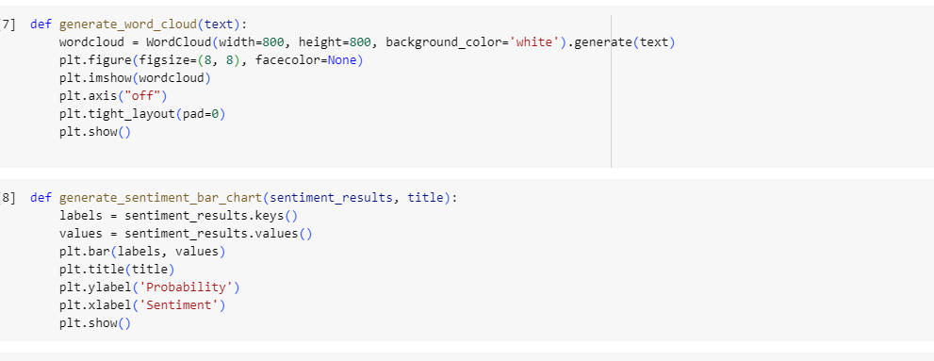
Sentiment analysis using python

Slide 7
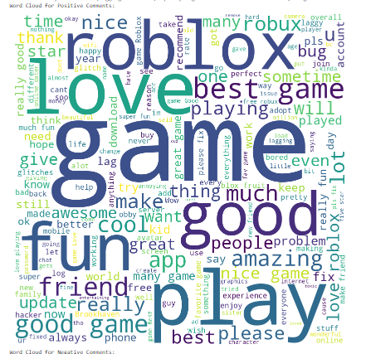
Positive wordcloud using python

Slide 8
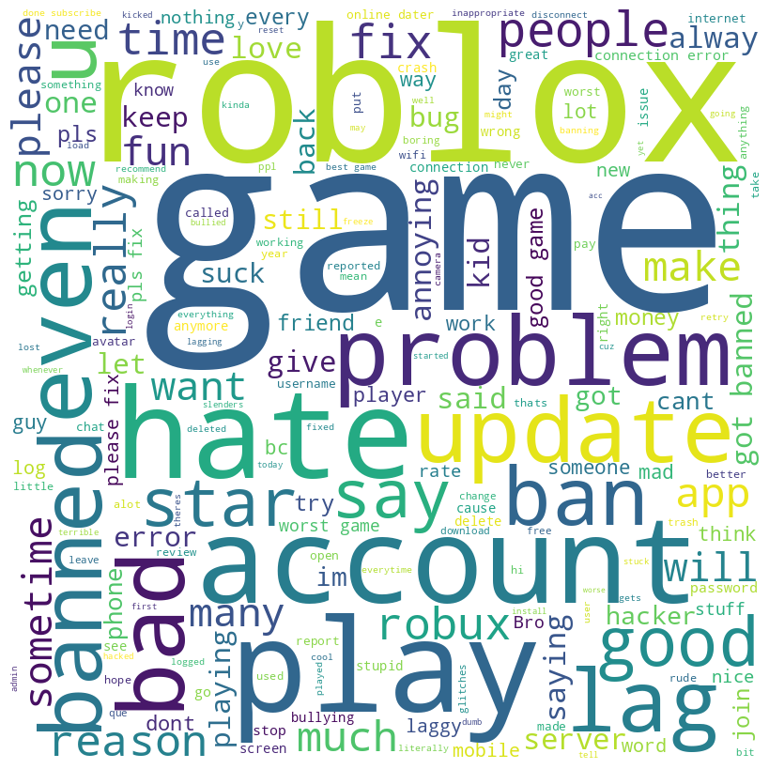
Negative wordcloud using python

Slide 9
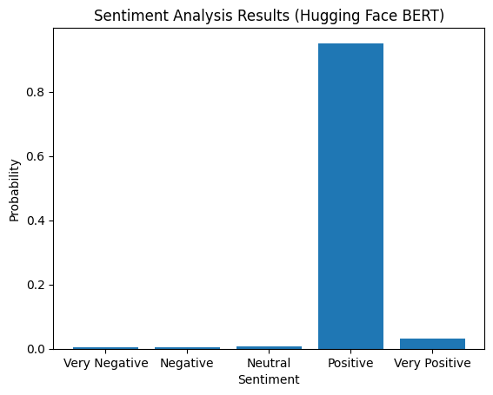
Hugging face analysis

Slide 10
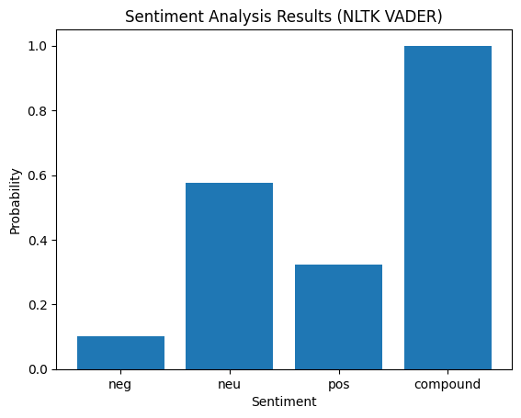
Nltk analysis

Slide 11
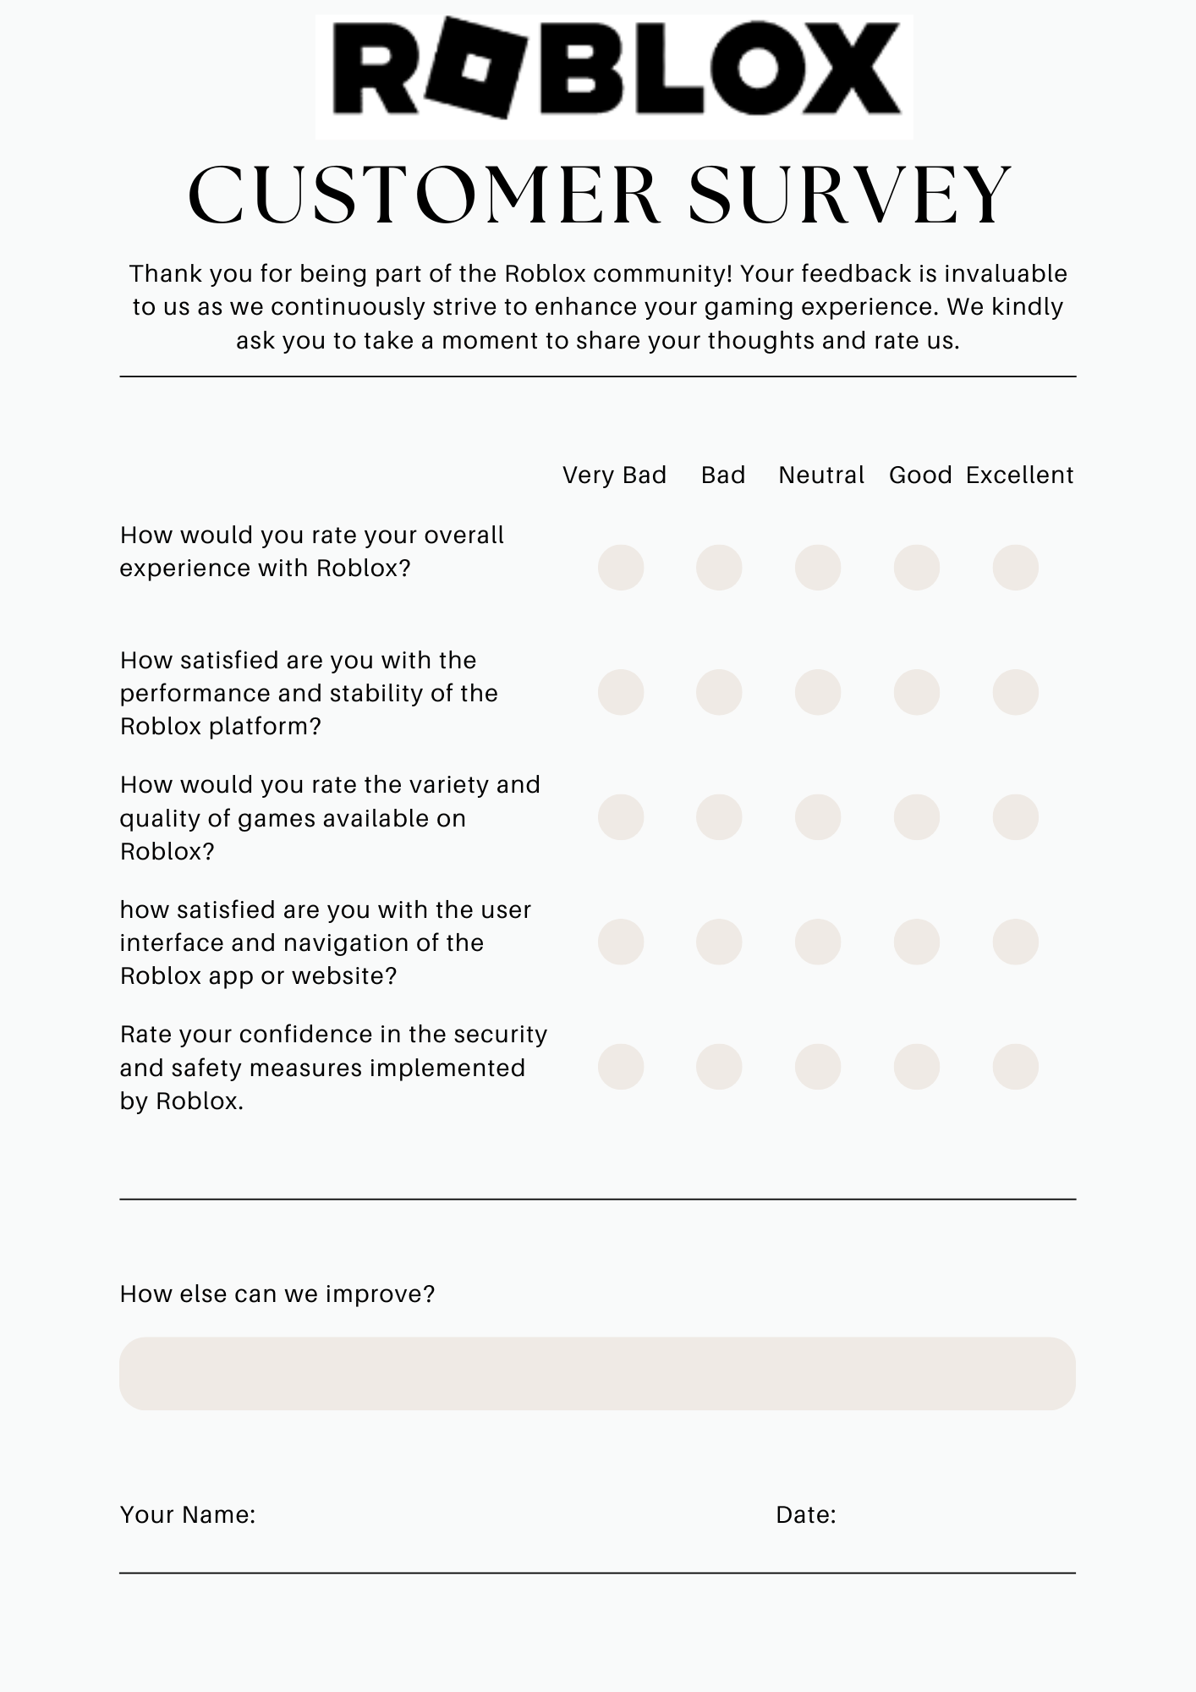
Customer feedback form

Slide 12
Conclusion
The sentiment analysis of the Roblox dataset offers valuable insights into the sentiments expressed by users towards the platform and its content. By analyzing a sample of reviews from the dataset, we were able to gain a deeper understanding of the overall sentiment trends, identify common themes, and assess the general sentiment polarity of the user feedback. The sentiment analysis revealed that the majority of reviews exhibited a positive sentiment, indicating that users' opinions towards Roblox are generally balanced and positive in nature. The findings of this sentiment analysis can inform strategic initiatives aimed at fostering a positive and engaging environment for the Roblox community.

